Slide 1



Support Tools to Enhance Participants Retention in Mental Health Clinical Trials
Yu Chen^{1,3}
Samaneh Kouchaki^{2,3}
Ramin Nilforoshan^{3,4}
Payam Barnaghi^{1,3}
¹Department of Brain Sciences Imperial College London
²Centre for Vision, Speech, and Signal Processing, University of Surrey
³Care Research and Technology Centre UK Dementia Research Institute (UK DRI)
⁴Surrey and Boarders Partnership NHS Trust

Slide 2
Supporting researchers
Significant variation exists among different centres in terms of their approaches to participant recruitment, trial design and retention.
Variation can stem from several factors, including differences in resources, patient populations, and research priorities.
Objectives:
Learn best practices from existing studies conducted across research centres to support trial design.
Provide a dynamic system that support researchers though long trials based on granular information on subjects and other aspects of trial.
2
Notes:
Include Miner branding name on here, so that this can be introduced

Slide 3
Supporting participants
Limited interaction between participants and researchers throughout current trials.
Participant will be only contacted to remind them of the next follow-up and no automatic update of trial outcomes.
Objectives:
Create a a supportive, collaborative and transparent environment fostering ongoing updates and interaction with participants.
keeping participants informed and engaged in their own mental health journey.
3
Notes:
Include Miner branding name on here, so that this can be introduced

Slide 4
Joint mental health research
In dementia and cancer research, individuals are recommended to join research trials.
Participants in research always have better outcomes in their clinical setting.
There are also platforms enabling researchers and participants to register their interest and interact with each other (e.g. JoinDementiaResearch).
There is no similar platform in mental health research and hardly a long-term cohort trial.
Objectives:
Build a similar platform supporting mental health research.
Develop intelligent models enabling better matching of volunteers to trials.
Encourage researchers to design long-term cohort trial.
4
Notes:
Include Miner branding name on here, so that this can be introduced

Slide 5
Current developments

Slide 6
Researcher support platform
Considering existing trials and research papers, a number of variables are considered to estimate retention rate in mental health trials.
A graphical interface has been developed to enable researchers enter specific design information.
Machine learning models have been developed to estimate retention rate and suggest how researchers can improve retention rate in the design.
Currently is a static system but can be extended to a dynamic on-live support system.
6
Notes:
Include Miner branding name on here, so that this can be introduced

Slide 7
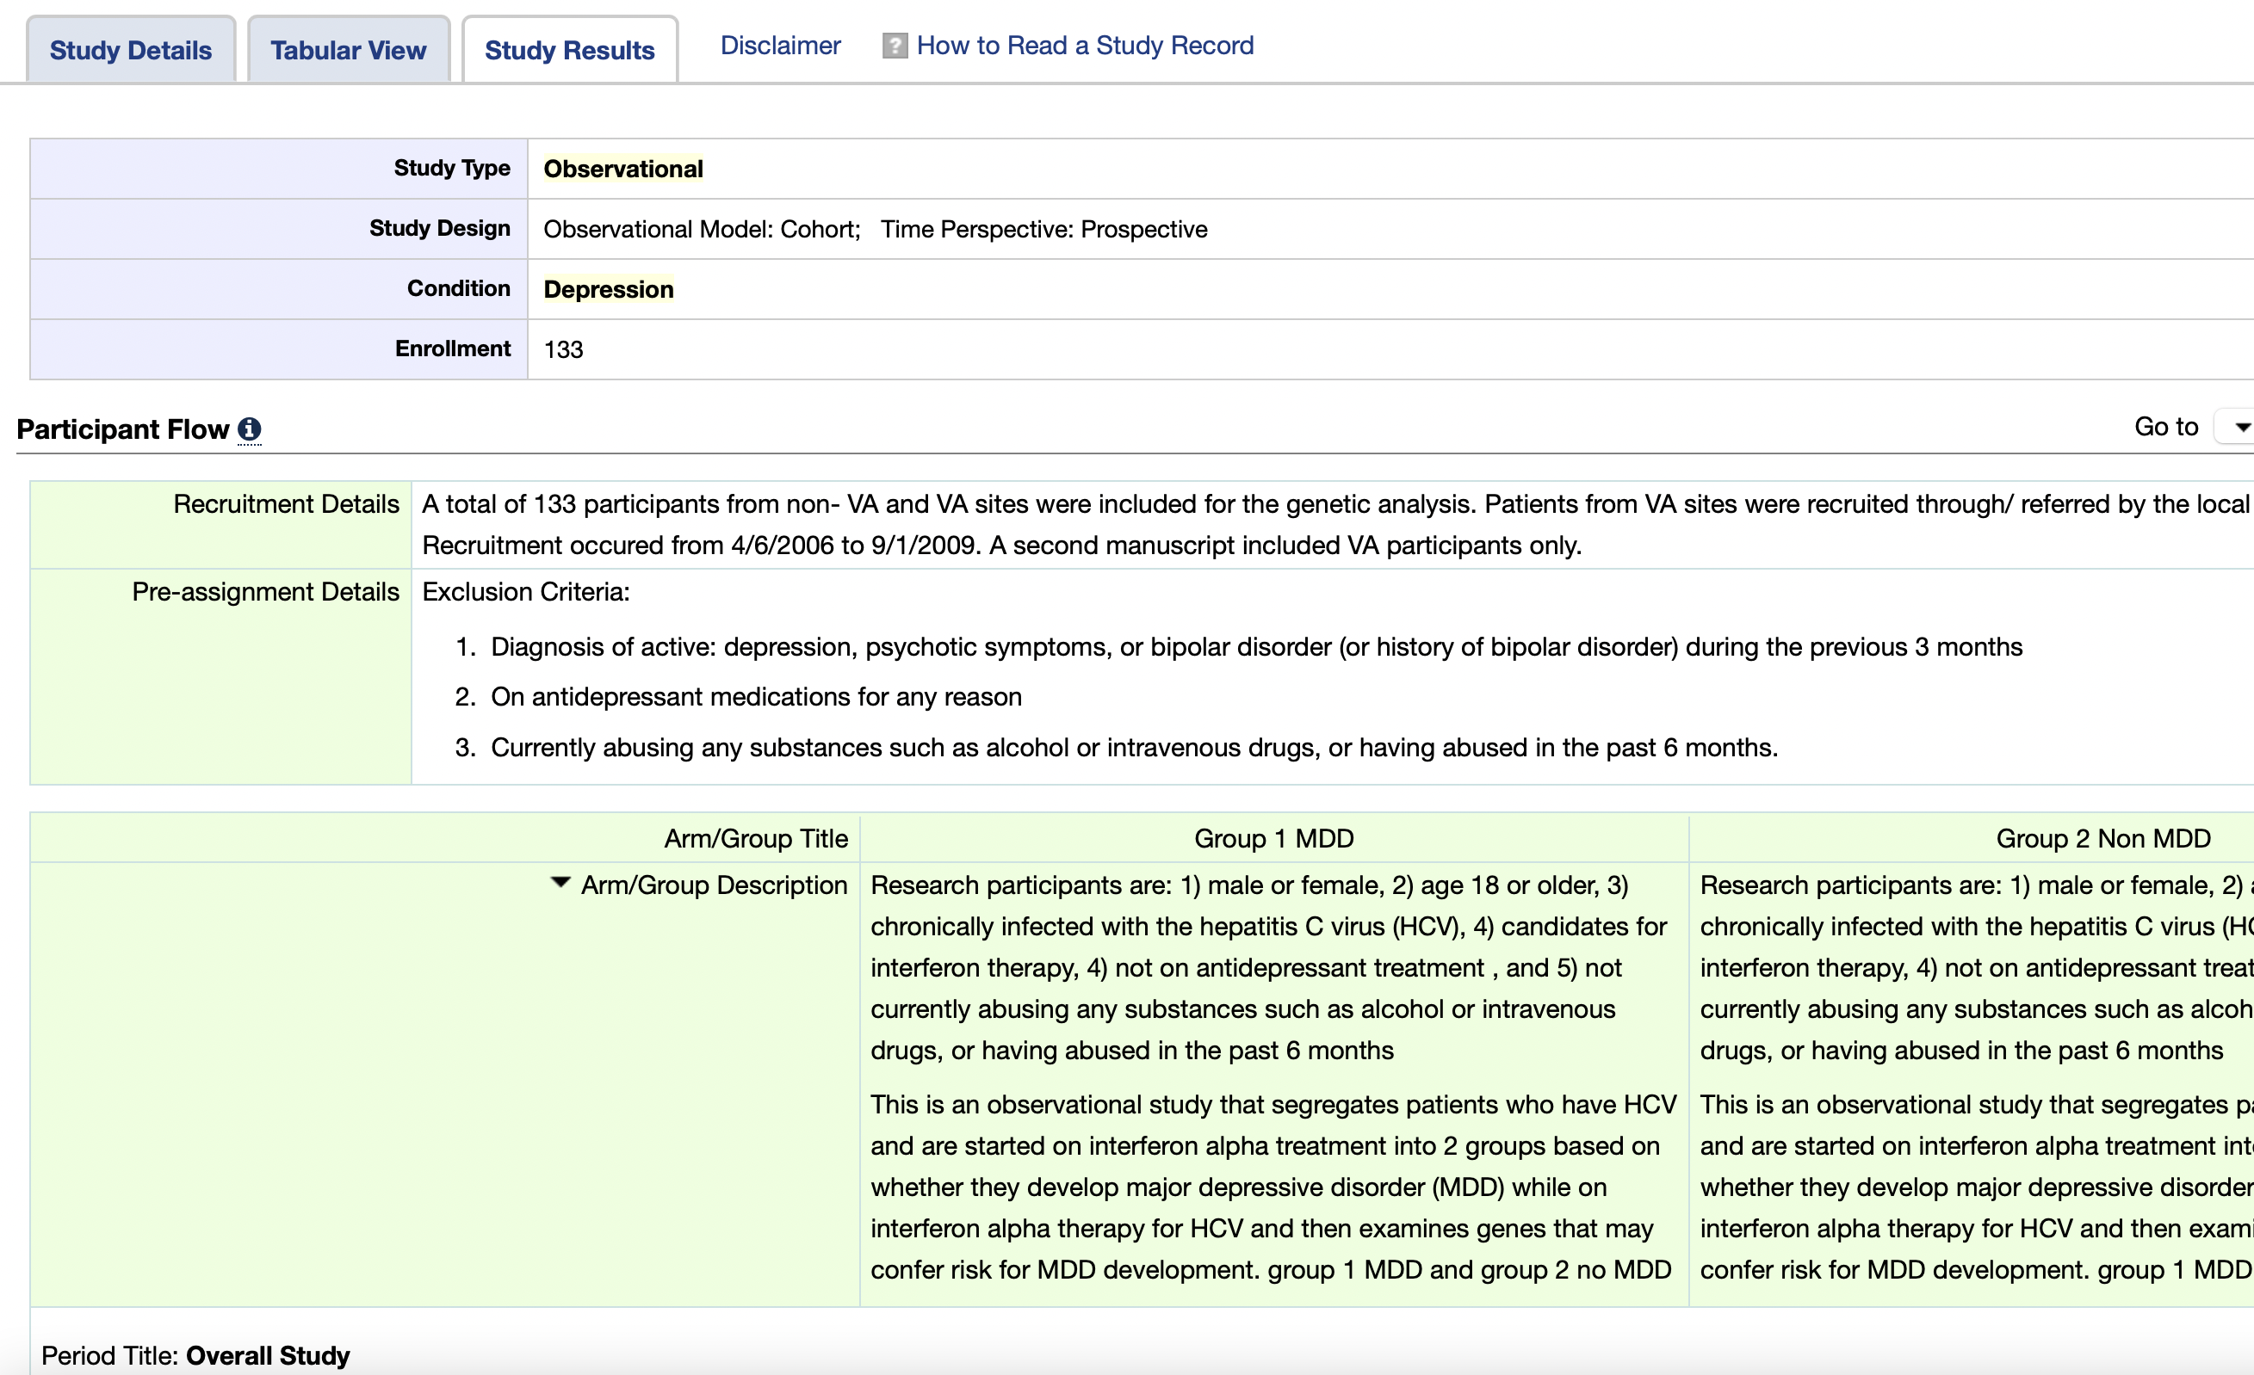
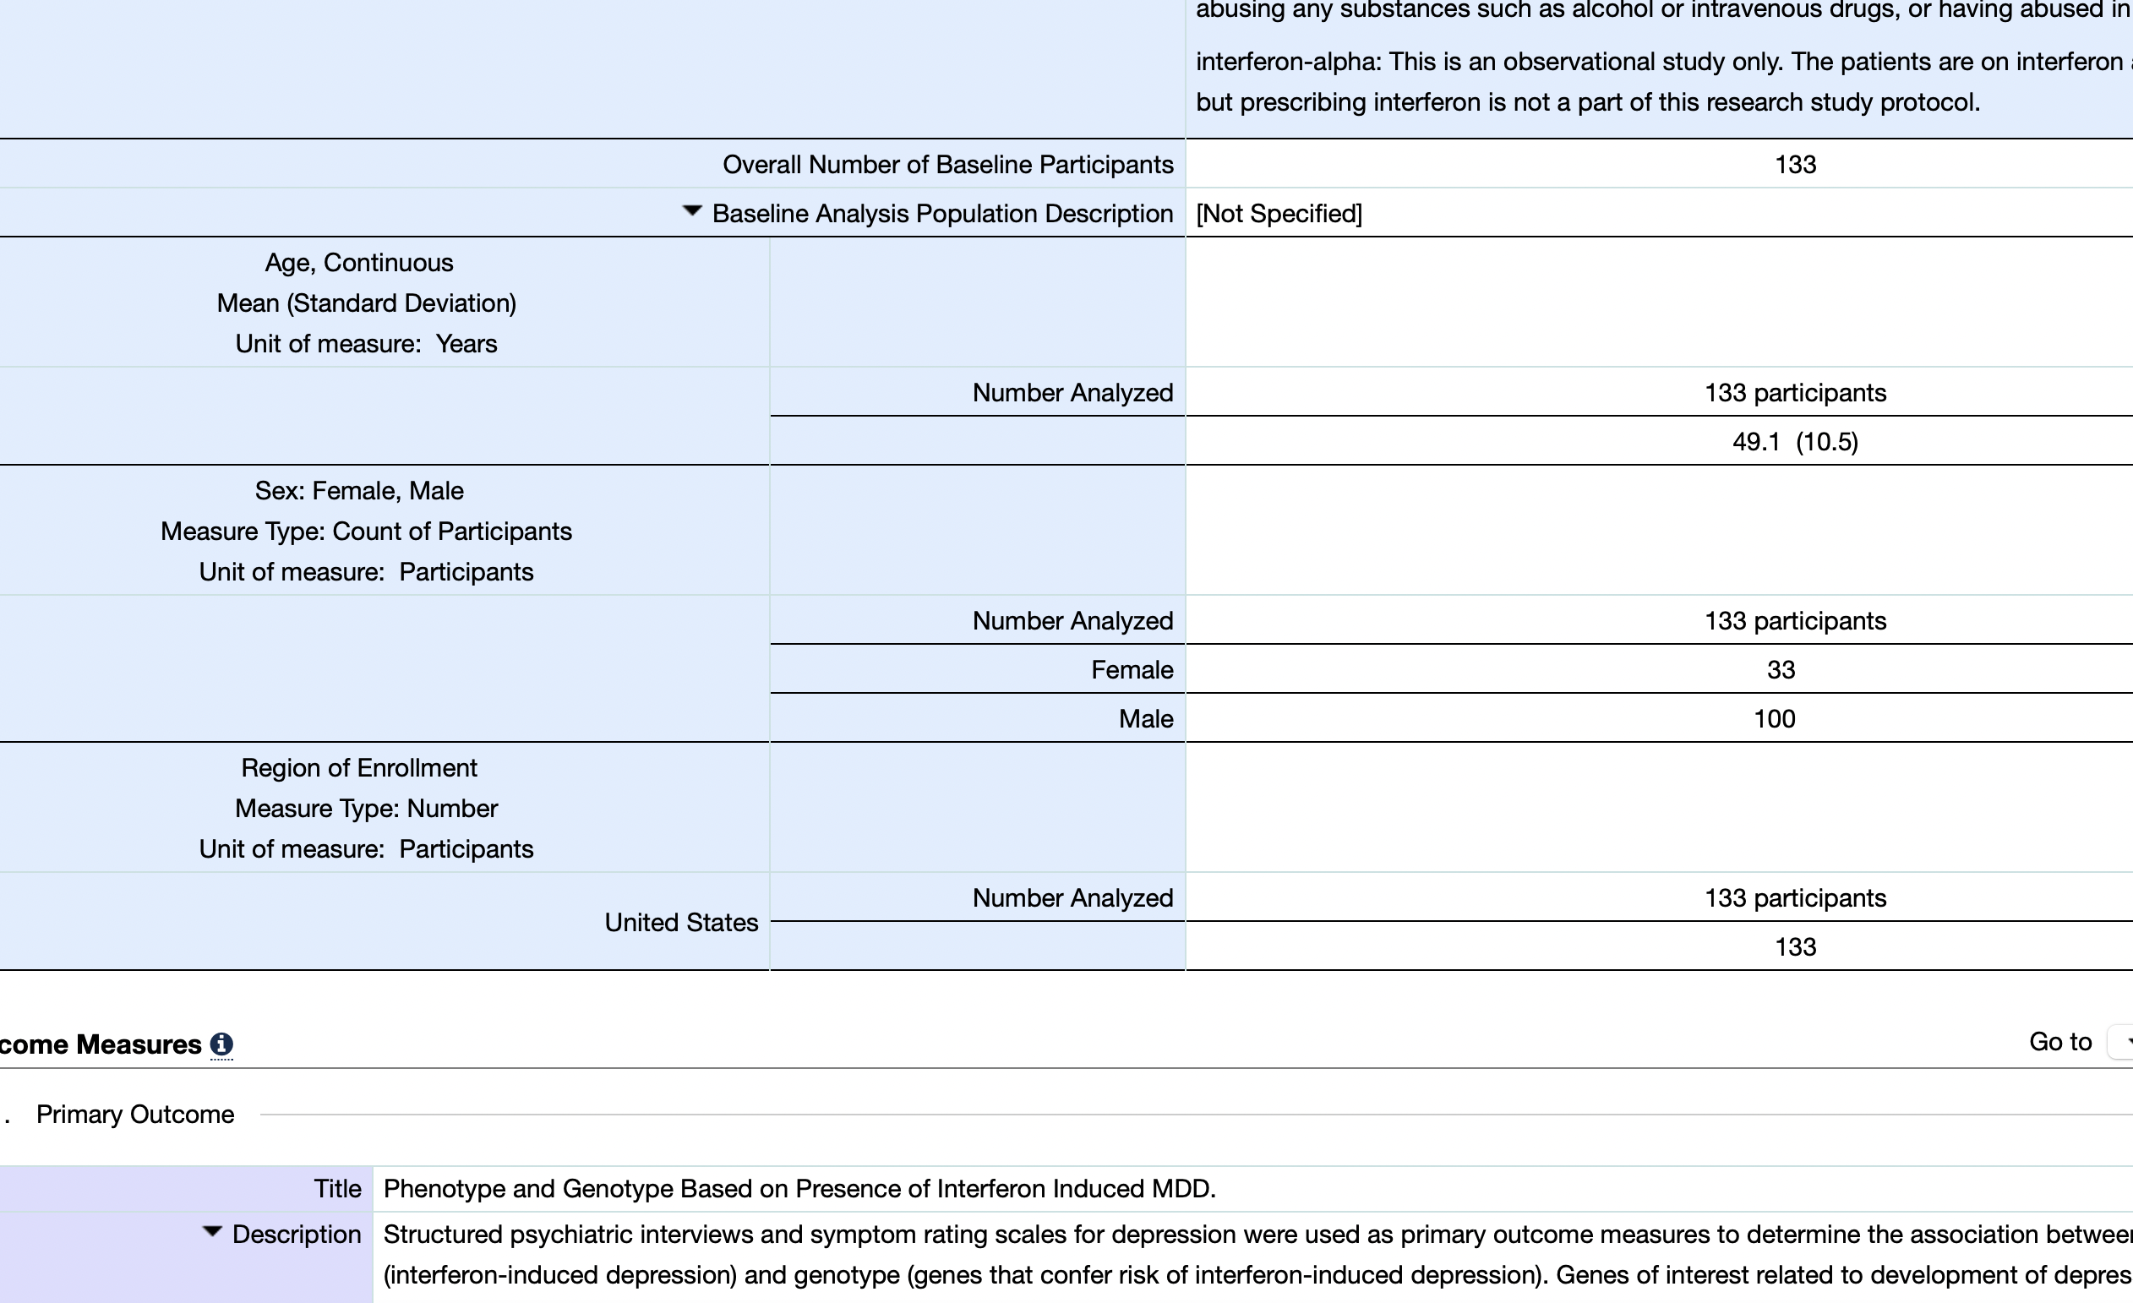
What we can learn from online trials data

Slide 8
Data simulation: Python code + json configuration + configuration examples
Supported variable type | Category, Float, Integer
Supported distribution | Normal, Uniform, truncated Normal, Beta, Dirichlet
Supported structure | Independent, conditional
Supported conditions | Single condition, multiple conditions (joint by “and”, “or”), linear conditions (the target variable is a linear combination of some other variables)
{ "n_samples": 50000,
"independent":{
"n_participant": {
"type": "int",
"distribution": "Uniform",
"low": 50,
"high": 100000
}
}
……
“conditional”:{
"retention_rate”:{
"type": "float",
"distribution": "Beta",
"conditions":[
{
"condition_conjunction": "linear",
"feature_names": ["duration","support_sessions"],
"feature_values": [-0.001,[0.05,"yes"]],
"bias":0.9
}
]
}
}

Slide 9
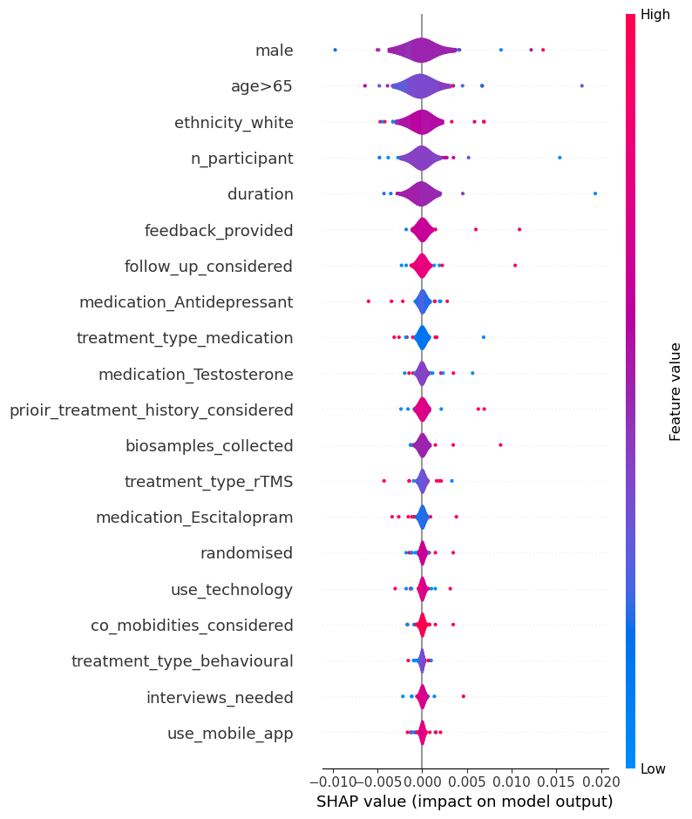
Retention rate estimation and feature ranking
Linear regression and Gaussian process were considered for retention estimation.
We checked more than 40 online trials to understand which variables to consider.
We created a simple SHAP visualisation but note that this is based on small number trials.
Estimates show very low MSE score for both online trails and simulated data (<0.02).

Slide 10
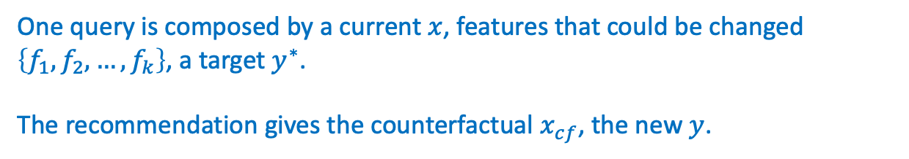
Counterfactual feature recommendation
Which feature should be changed to get an expected result?
$$x_{cf}=\arg{\min_{\left\{x_{i} | i∈\left\{f_{1},f_{2},…,f_{k}\right\}\right\}}(m_{θ}\left(x\right)−y^{∗})^{2}+cost(x,x_{cf})}$$
Where $θ$ denotes parameters of a trained model $m_{θ}$ for predicting $y$.
One query is composed by a current $x$, features that could be changed $\left\{f_{1},f_{2},…,f_{k}\right\}$, a target $y^{∗}$.
The recommendation gives the counterfactual $x_{cf}$, the new $y$.

Slide 11
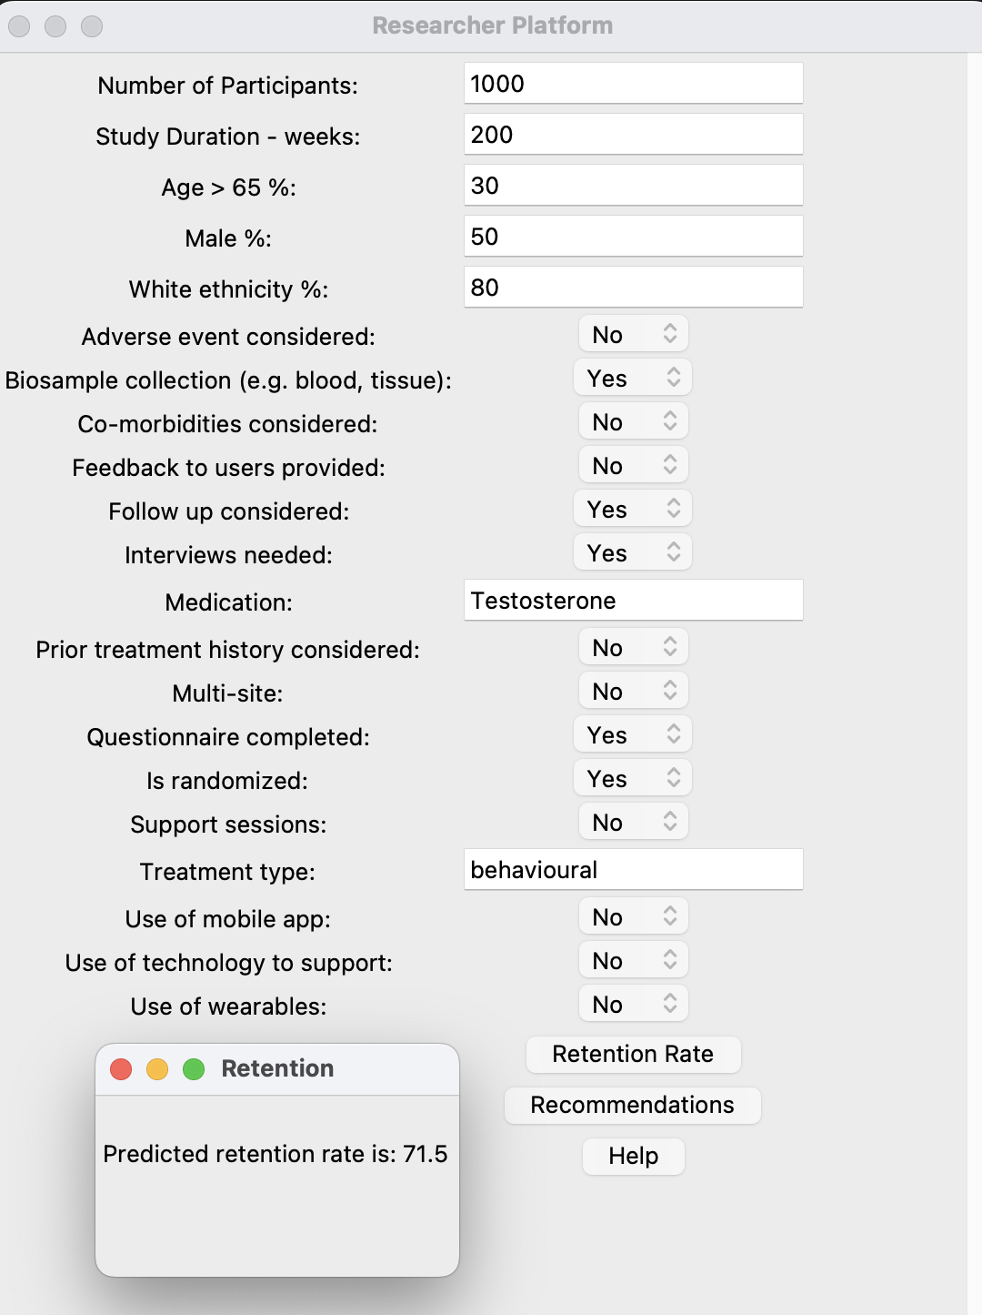
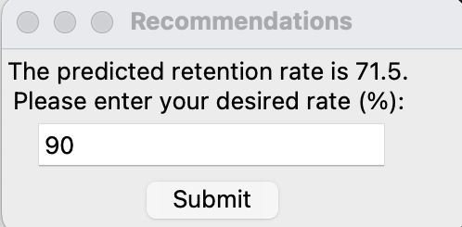
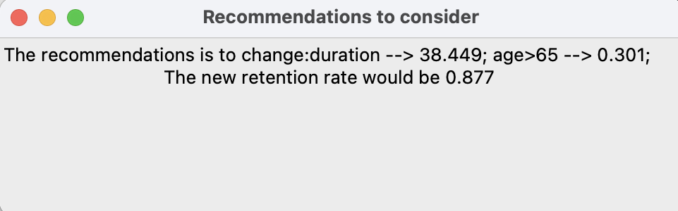
Current view - Research support platform

Slide 12
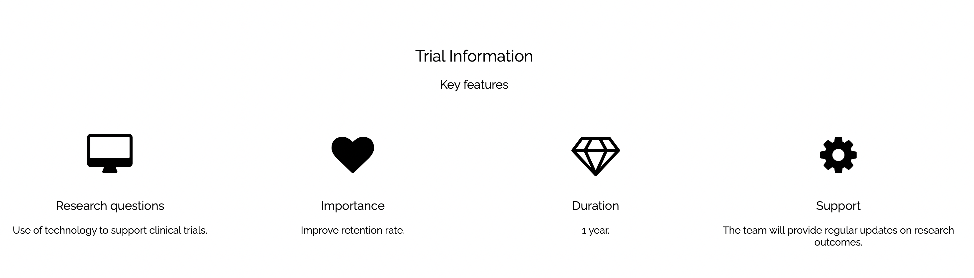
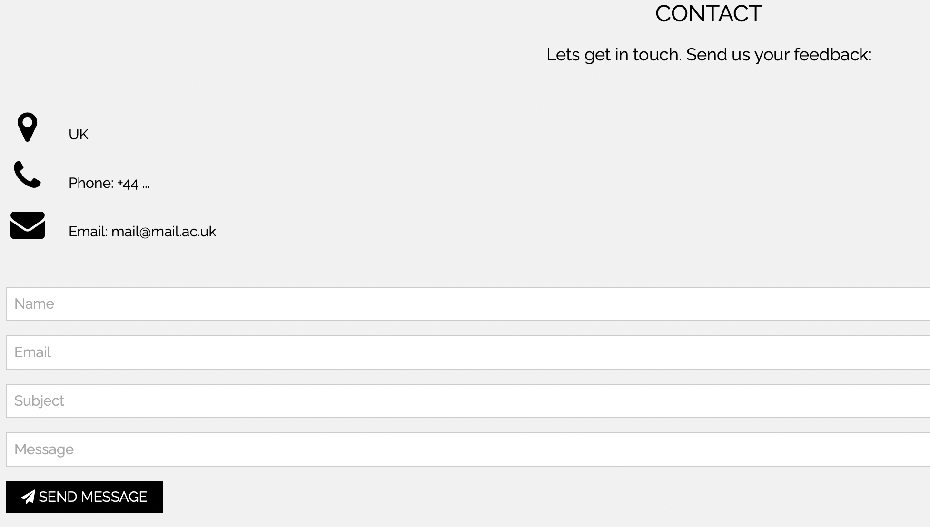
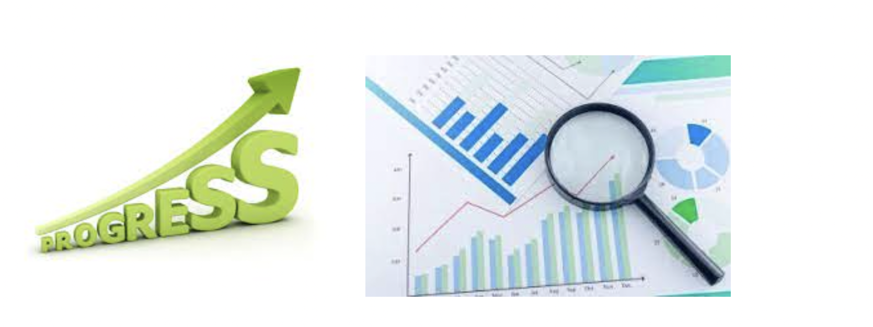
Participant support platform
Enable participants to receive information on all the possible trials internationally;
Enable researchers to communicate progress in lay term and provide training content and remind participant of upcoming follow ups (various means of communication will be enables in the final solution);
Enable two-way communications (questions and feedbacks) between researchers and participants.

Slide 13

Join Mental Health Research (JMHR)
Enable people with mental health or healthy volunteers to register their interest.
Enable researchers to register and find interested participants.
Enable both groups to receive support information.
Motivate participants of the importance of these trials and match them to an appropriate trial.
Enable NHS and industry to plan trials based on calculated estimation.

Slide 14
Impact, evaluation and user needs

Slide 15
How the design improve the long-term retention?
Reduce stigma attached mental health research
Enable two-way communication as an integral element of our solution
Support participants throughout clinical trials by enabling them to be an active part of the research and provide them with training materials.
Improve Patient and Public Involvement and Engagement
Support researchers prior the start and throughout clinical trials by helping them learn best practices and provide them with regular suggestions.
Use of machine learning approaches to match participants to trails to ensure its benefits to both participants and researchers and understand who will retain longer.
15
Notes:
Include Miner branding name on here, so that this can be introduced

Slide 16
Evaluate the impact of our application? Discover early utility of the application and likelihood of success in ten years within short period
User involvement and feedback – will be considered throughout the project.
Collaborations and discussion with researchers and clinicians – the team has extensive collaboration with various research institutes and mental health researchers
Evaluation based on existing data and cross-validation – existing evidence, research trials and data access through our collaborators
Accessibility and reach of the application – to all population nationally and internationally (accessible to all gender, ethnicity, age…)
Platform will be accessible to National Institute Health and Research (NIHR)
Conducting a small-scale pilot study
Our platforms can be set in a mental health trial,
Evaluations can be considered to understand their utility based on a number of indicators, e.g., satisfaction, increase in retention.
16
Notes:
Include Miner branding name on here, so that this can be introduced

Slide 17
How we considered the needs and requirements of research participants and researchers
Considering the experience of the clinical member of the team who has been involved in multiple clinical trials and worked with different research teams and patients.
Through active engaging with researchers and people with mental healthconditions.
By using good practices in other healthcare domains such as dementia research.
Through our trusted user groups.
17
Notes:
Include Miner branding name on here, so that this can be introduced

Slide 18

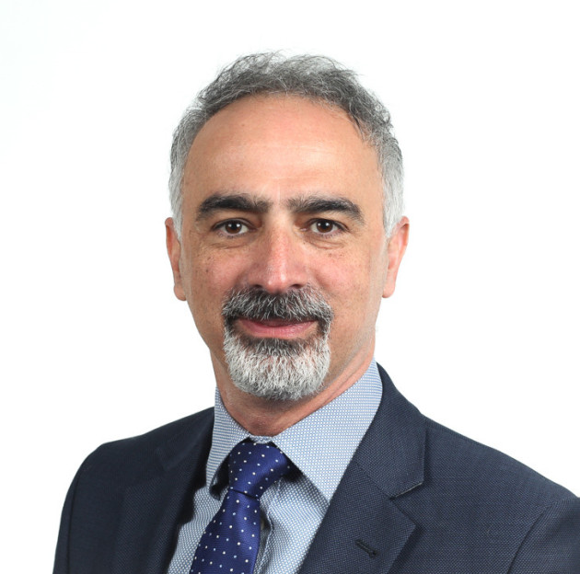


Our team and contributions
Yu Chen developed the simulated data generator, and machine learning for retention estimation and counterfactual feature recommendation model.
Samaneh Kouchaki developed the research support platform GUI and web interfaces and linked the machine learning codes to the GUI. She also helped in the early trial search.
Payam Barnaghi contributed to design of platforms, trial information extraction, and evaluation.
Ramin Nilforooshan contributed to the designs, insight into trials and challenges in mental health, and provided recommendations on clinical validation.
Everyone contributed to presentation and proposal writing.

